Slide 1
Liver Anatomy and Portal Hypertension

Slide 2
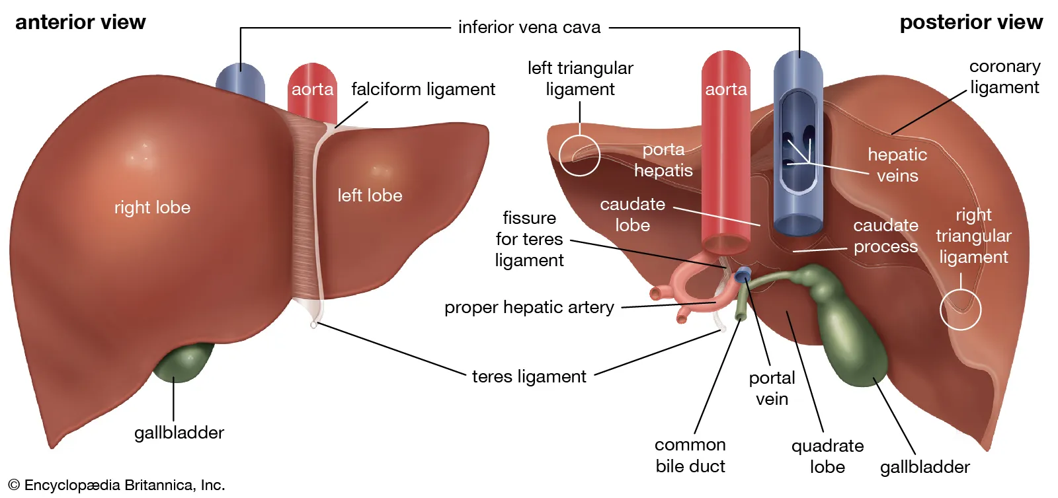

Slide 3
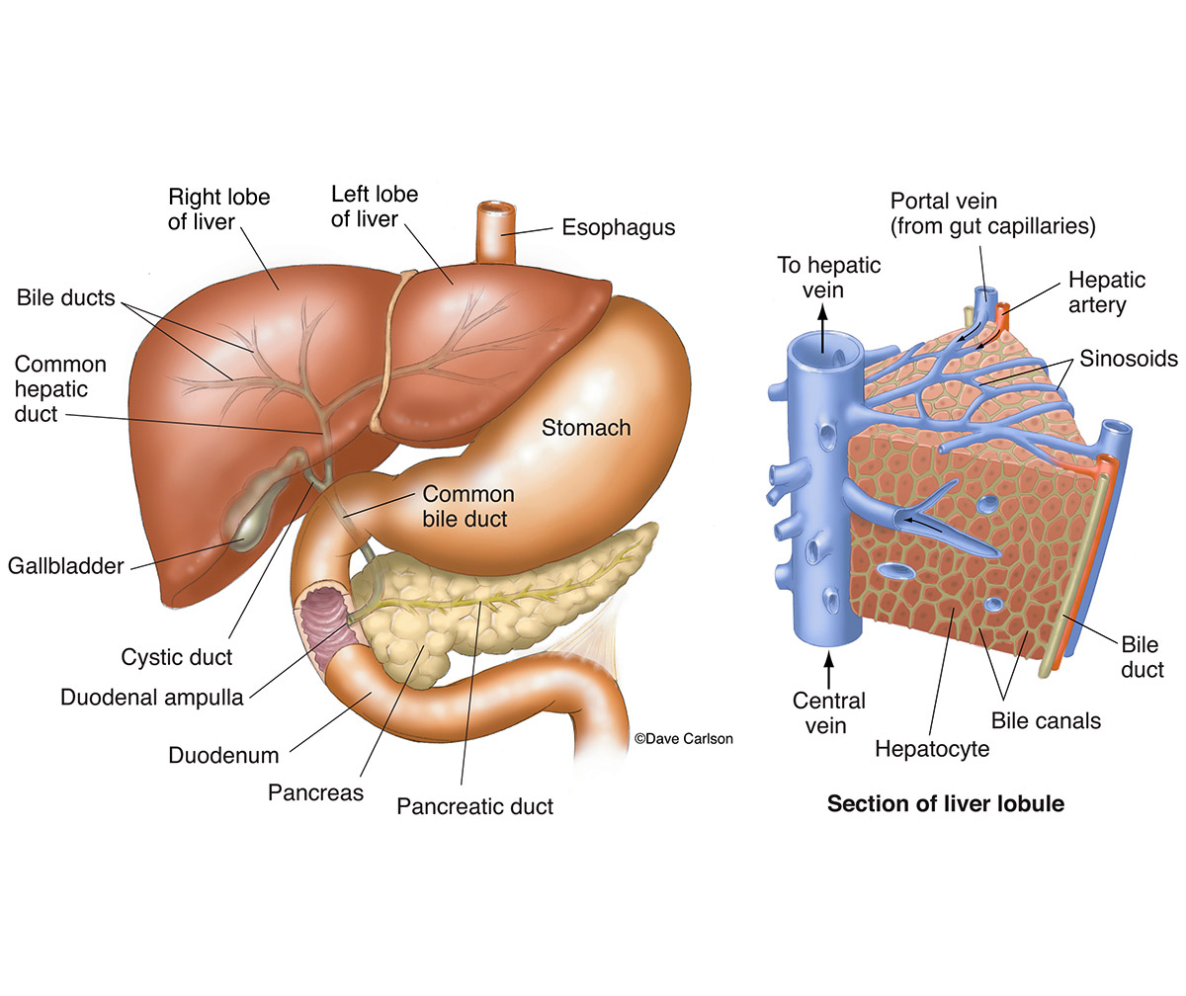

Slide 4
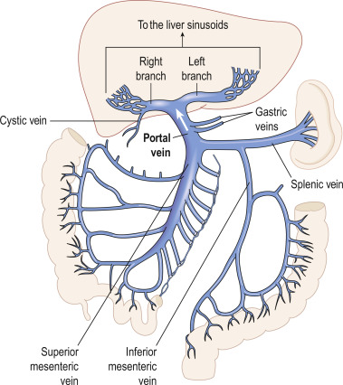

Slide 5
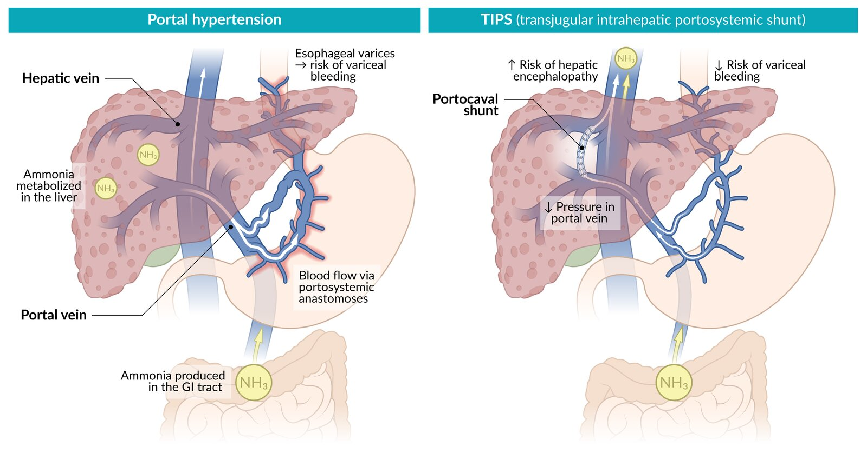

Slide 6
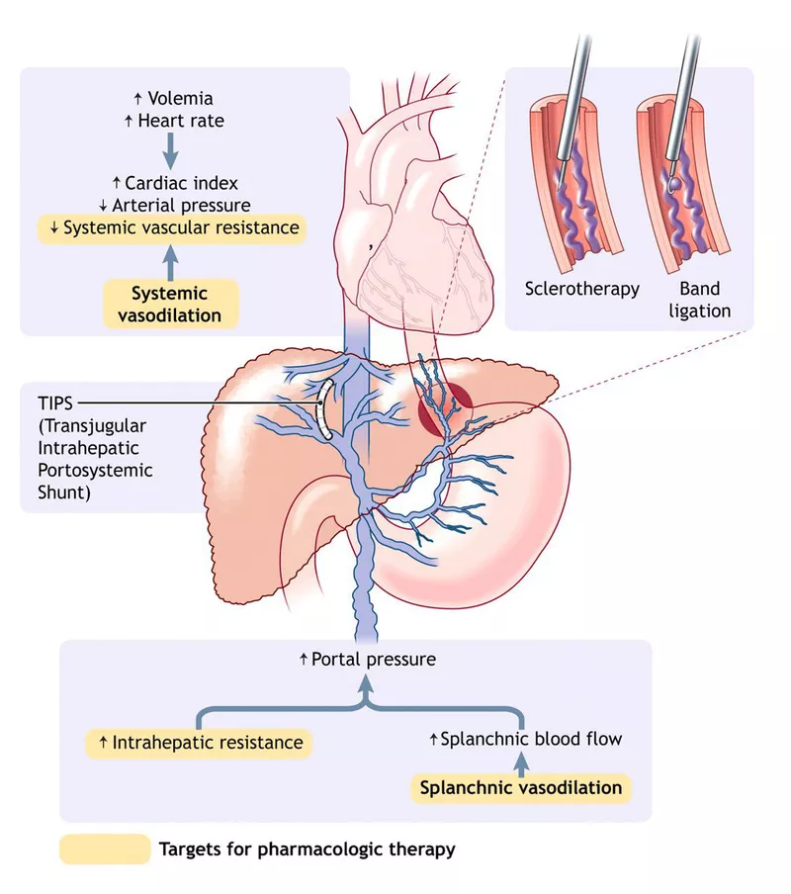

Slide 7
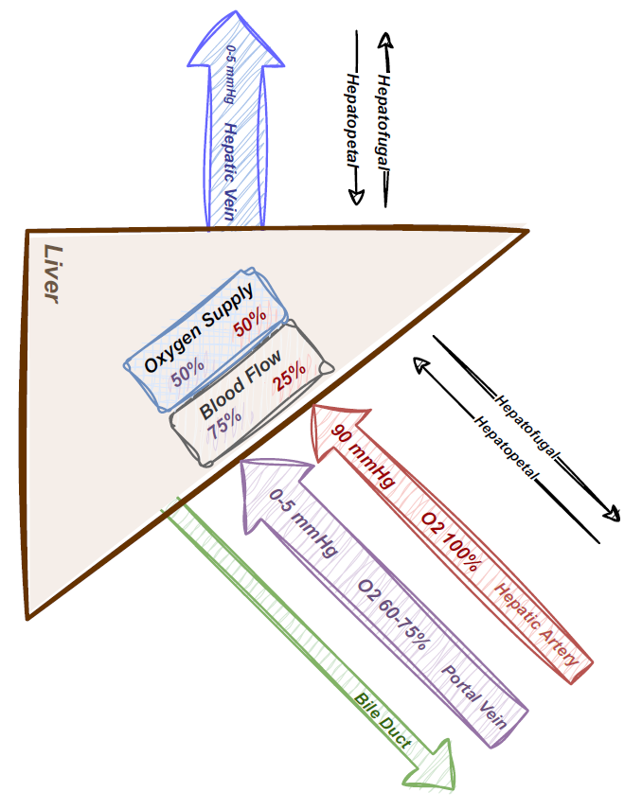

Slide 8
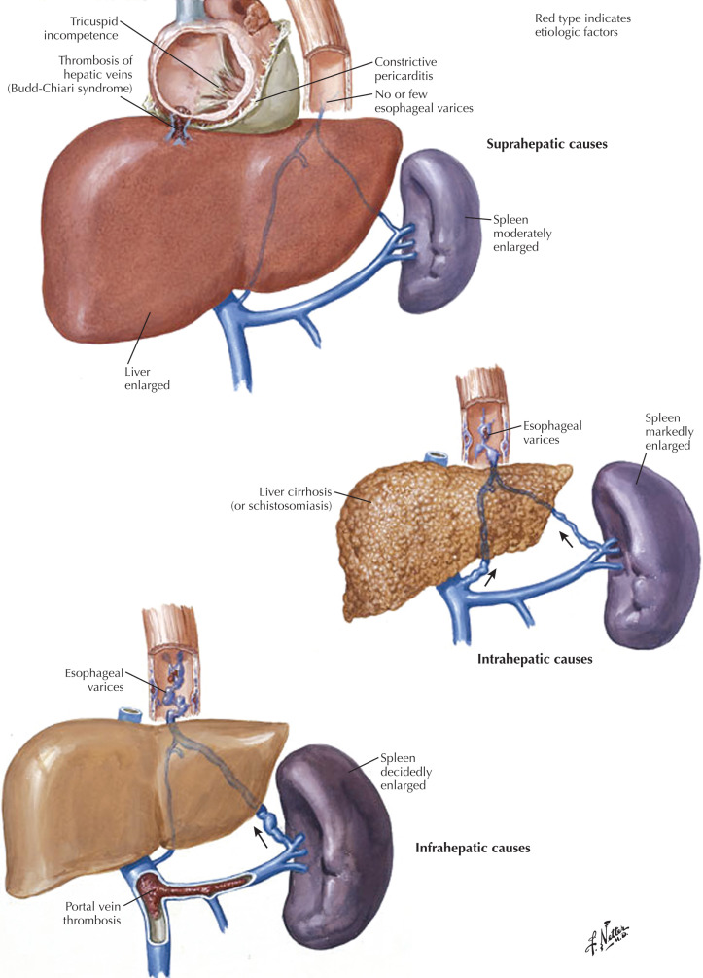

Slide 9
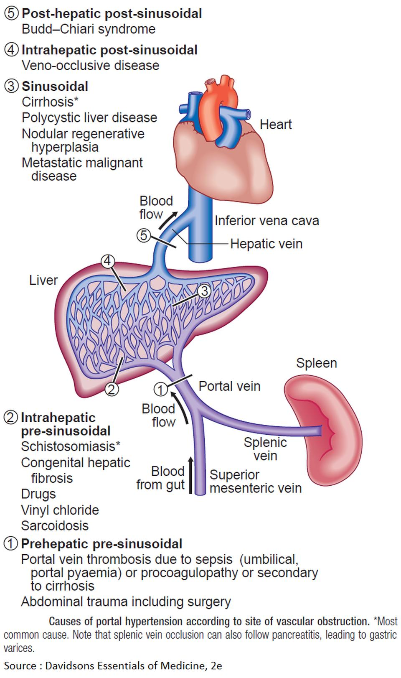

Slide 10
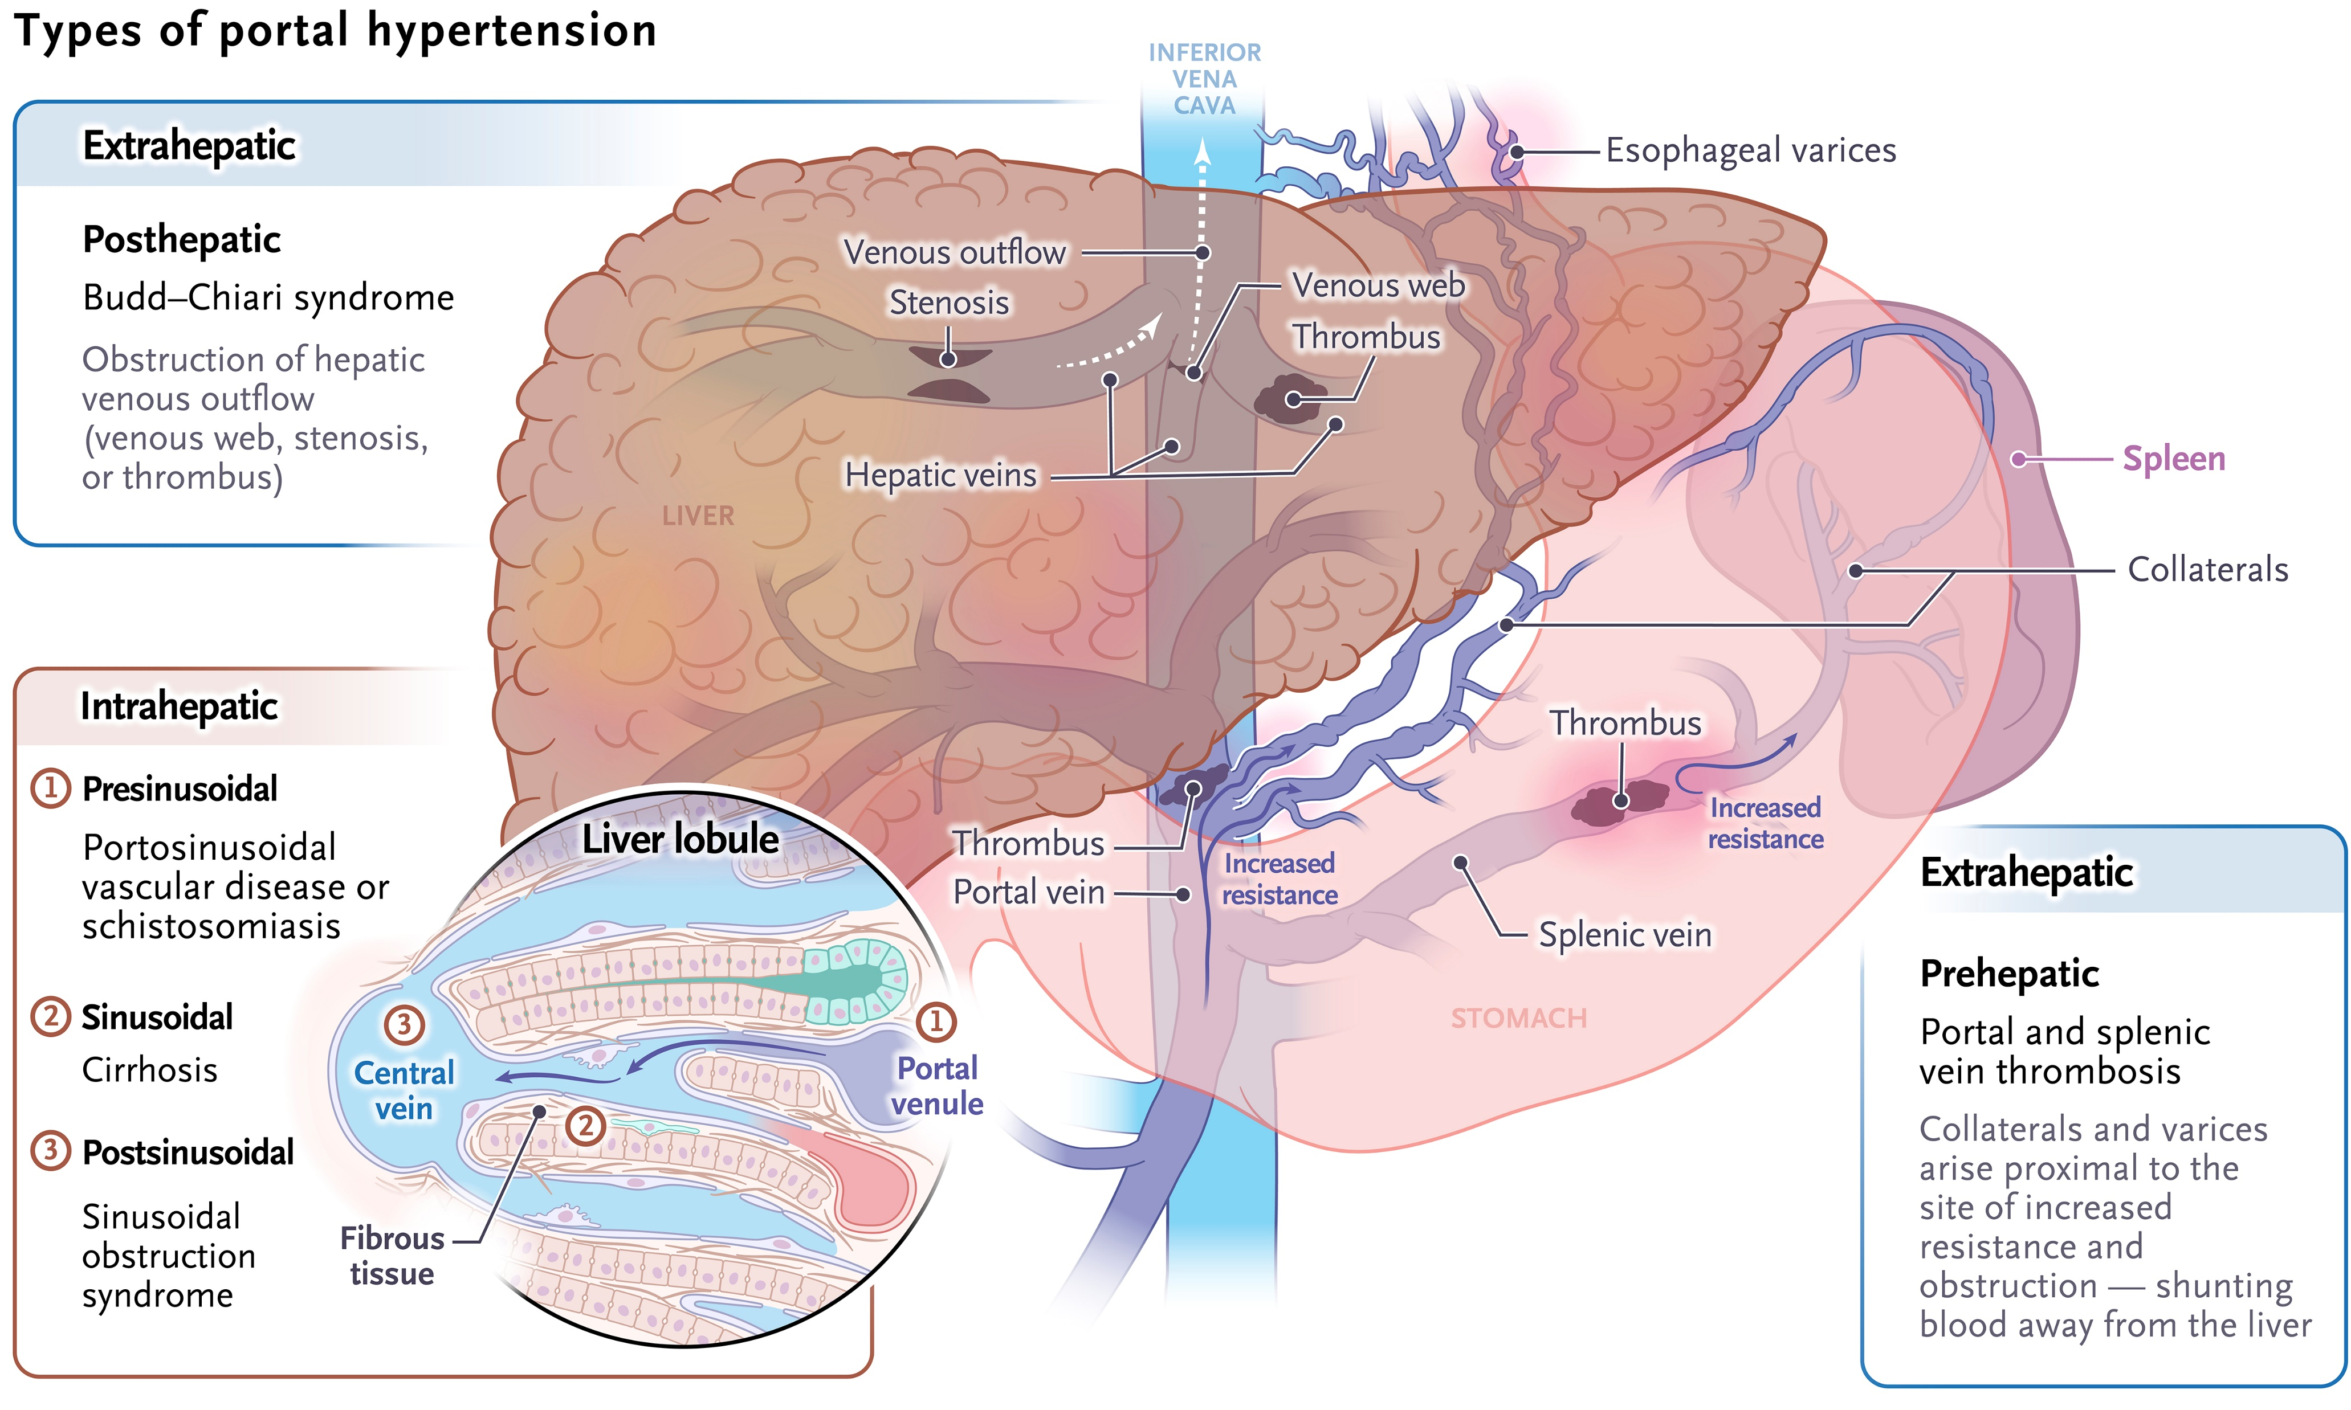

Slide 11
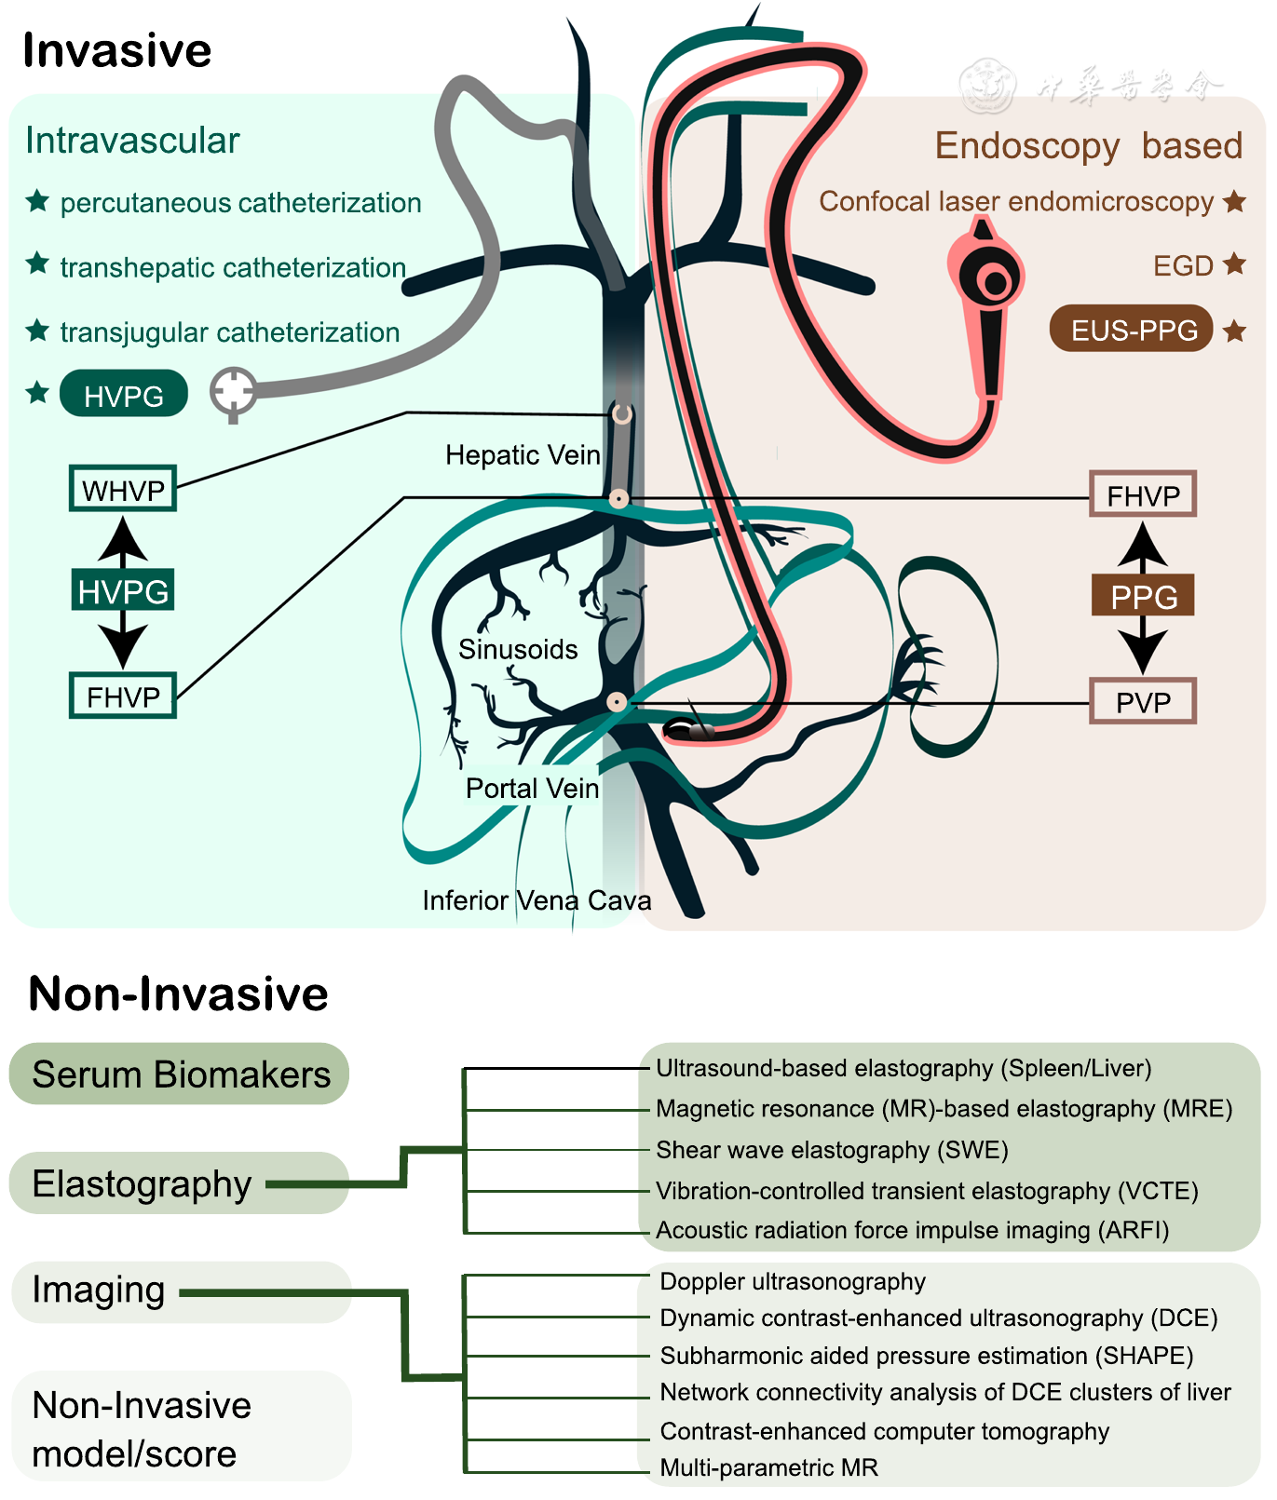

Slide 12
Etiology |  | IR/EUS | IR |  | EUS
Etiology |  | FHVP | WHVP | HVPG | PVP | PPG
Pre-hepatic |  | ~ | ~ | ~ | ↑ | ↑
Intra-hepatic | Pre-sinusoidal | ~ | ~ | ~ | ↑ | ↑
 | Intra-sinusoidal | ~ | ↑ | ↑ | ↑ | ↑
 | Post-sinusoidal | ~ | ↑ | ↑ | ↑ | ↑
Post-hepatic | Budd-Chiari | N/A | Cannot cannulate HV | N/A | ↑ | ↑
 | Others | ↑ | ↑ | ~ | ↑ | ~
FHVP: Free hepatic vein pressure = RA pressure WHVP: Wedged hepatic vein pressures HVPG: Hepatic venous pressure gradient = resistance of blood flow through the liver (intrahepatically) HVPG = WHVP - FHVP PVP: Portal vein pressure = definition of portal hypertension PPG: Portal pressure gradient PPG = PVP - FHVP

